Slide 1
Solidity and More About Ethereum

Slide 2
Ethereum networks consist of computers which are used to transfer money and store data.
There are different ethereum networks.
The networks consist of one ore more nodes.
Each node is a computer that is running as an ethereum client.
Any participant can run a node, and each node contains a copy of the ethereum blockchain.
Node
Node
Node
Node
Node

Slide 3
There is one main ethereum network that everyone uses for their deployment of production applications.
But, there are test networks used only for testing code and testing transactions.
Anyone can create his/her own private ethereum network on his/her own computer that is restricted to the owner of the computer, or the owner of the computer can open his/her network to others.

Slide 4
How people can connect to the ethereum network and make changes to it like sending money or storing data or anything else.
Generally, there is two different sets of technologies for getting connected to the network:
The first set of technologies are used by developers to create actual applications that talk to the network by using a library called web3.js.
The second set of technologies are used by consumers (non programmers):
Metamask is a Chrome extension that allows ordinary people to interact with the ethereumm network.
Mist Browser is a full featured web browser that is used to browse different ethereum applications.

Slide 5
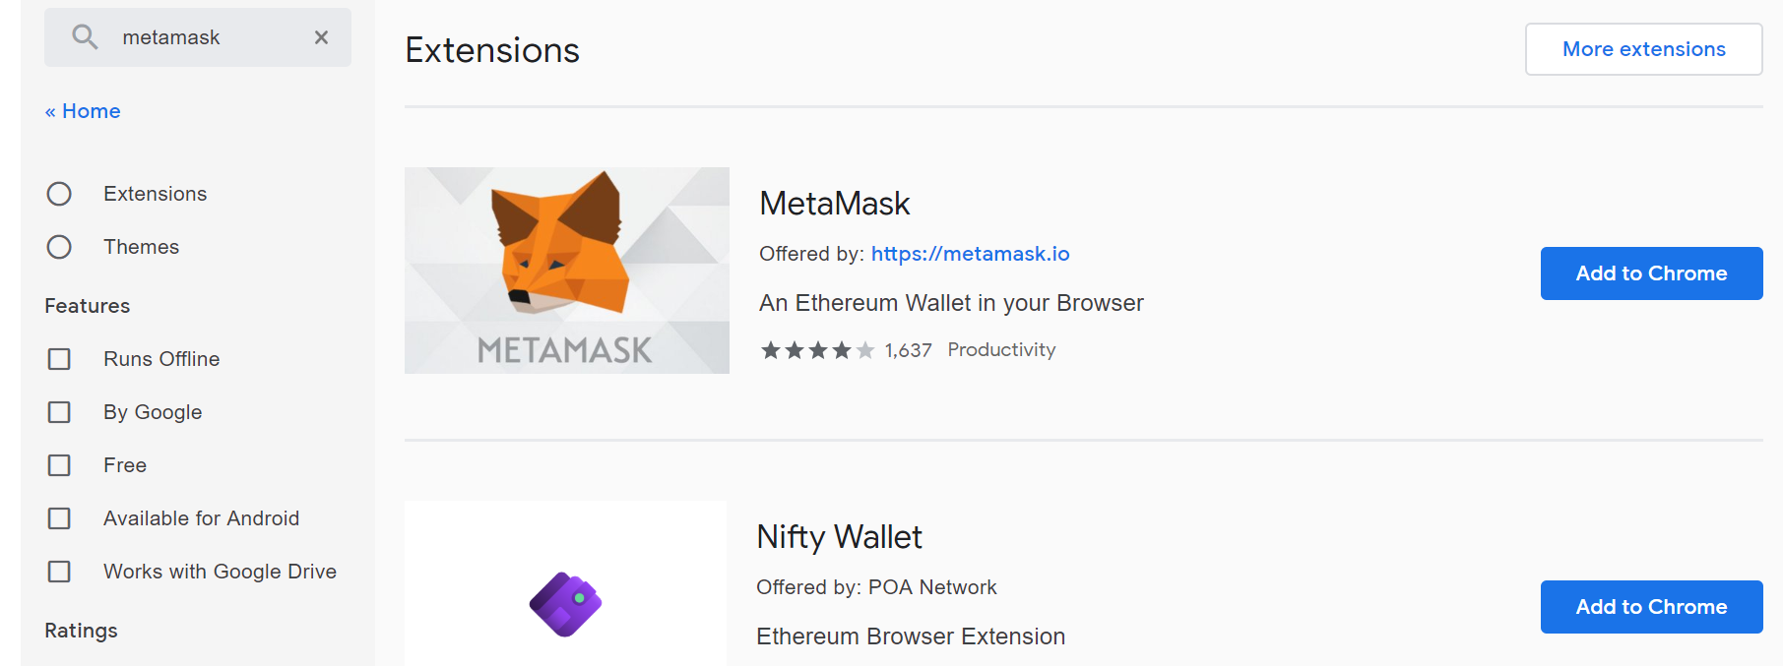
Metamask Setup
Open a new tab in chrome and paste the following link:
https://chrome.google.com/webstore/category/extensions
In the search box search for Metamask, you will get the following:

Slide 6
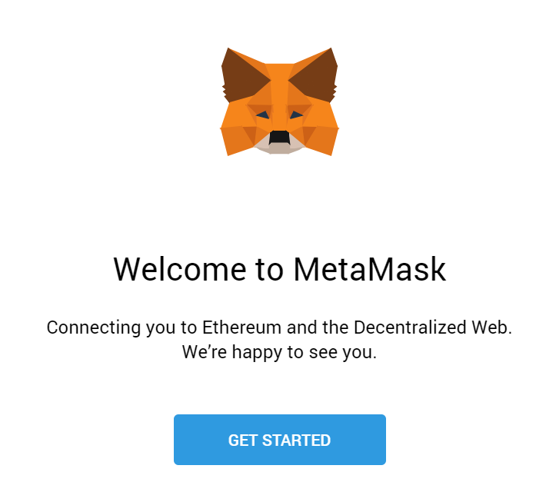
Choose the first option (fox icon) by clicking on add to chrome, it will be downloaded, and you will see the fox icon on your chrome browser right the search box.

Slide 7
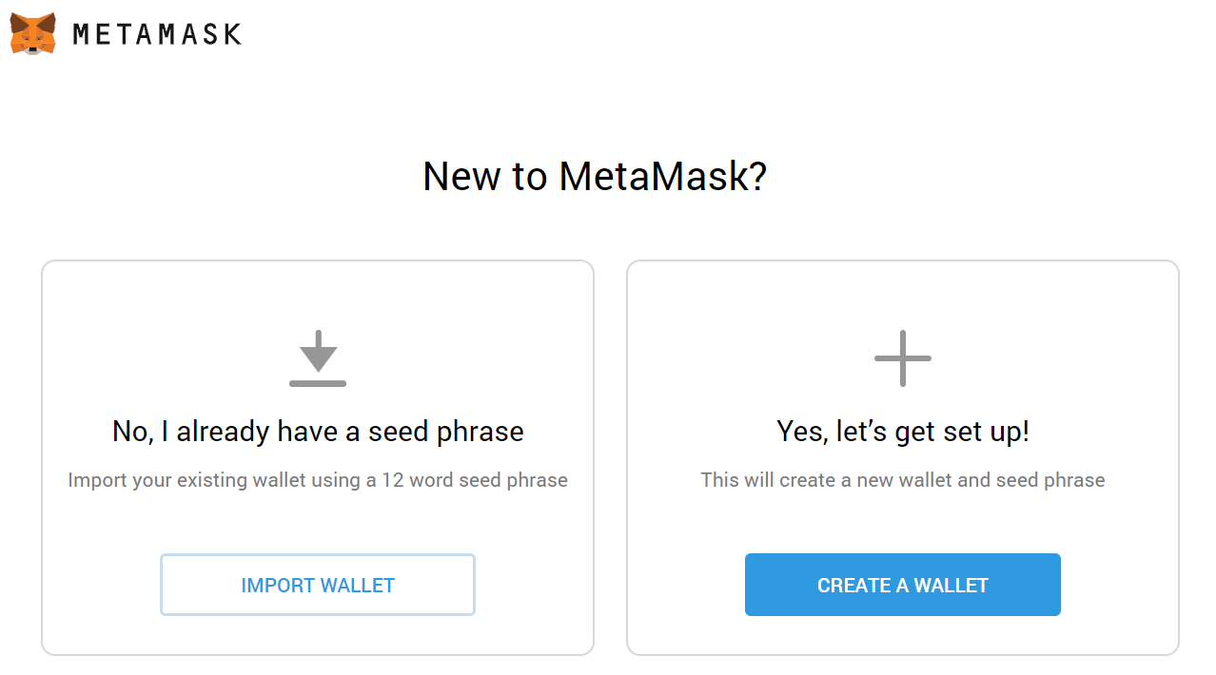
Click on get started and you will get

Slide 8
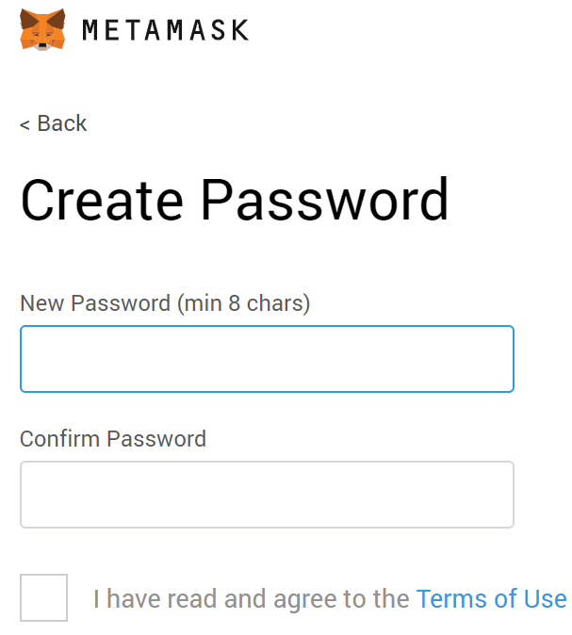
If you are using Metamask for the first time choose create wallet, otherwise choose import wallet.
Then it will ask you to create a password

Slide 9
Tips on storing seed phrase (mnemonic) safely
• Save a backup in multiple places.
• Never share the phrase with anyone.
• Be careful of phishing! MetaMask will never spontaneously ask for your seed phrase.
• If you need to back your up seed phrase again, you can find it in Settings -> Security.
• If you ever have questions or see something fishy, email support@metamask.io.

Slide 10
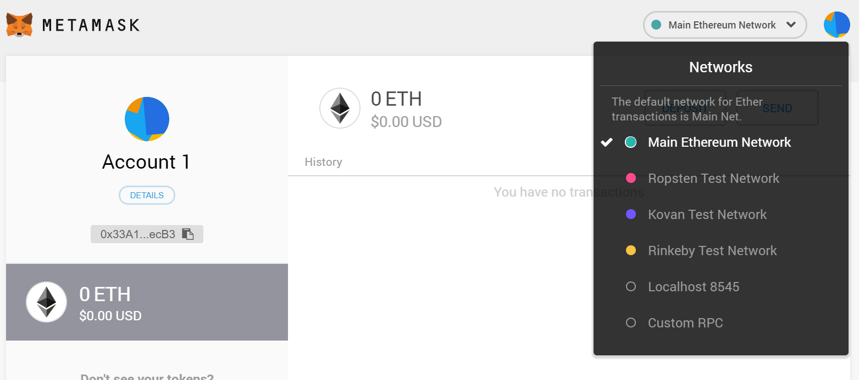
The account we created on Metamask will allow us to send and receive money, also it will allow us to deploy smart contracts.
The first network that is selected by default is the main network the main network is the public production network it's where coins have a real value and that's where we deploy real applications that we want it to be used by other users.
The test networks are used to test code and to get free ether to test our contracts with.
Localhost 8545 is used when we are hosting a local ethereum node or a local ethereum test network.
Custom RPC allows us to connect to some remote network at some custom address .

Slide 11
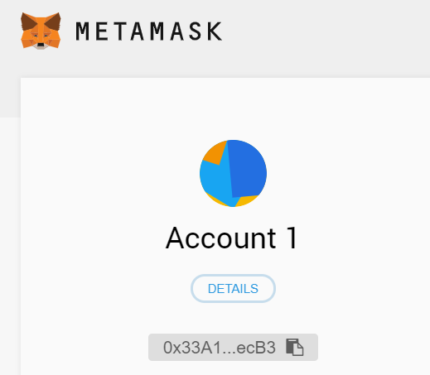
When we created our account on Metamask, Metamask provides the account with three different information.
The account address, public key, and private key all stored as hexadecimal numbers.
The public key and the private key are used to authorize sending of funds from your account to other accounts.
If someone does not have the private key to an account, they don't have true access to any of the funds that are assigned to that account.
Account Address: A unique identifier that can be shared with others and it identifies your account.
In the ethereum world, one account is used across all different networks, main, Ropsten, Kovan, Rinkeby, etc.
Metamask
Private Key
Public Key
Account Address

Slide 12
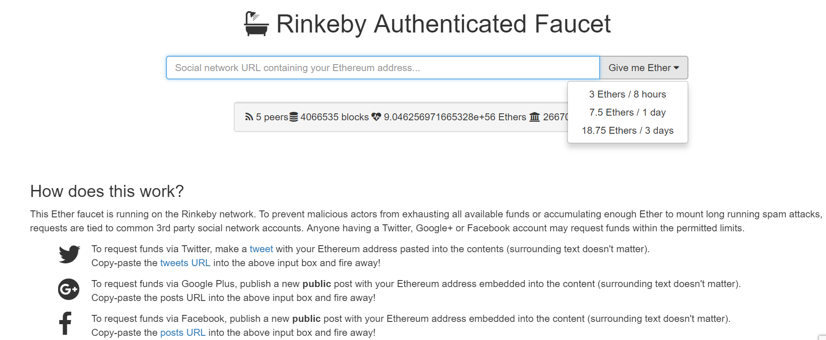
Sending and Receiving Ether
Go to https://faucet.rinkeby.io/
Choose one of :

Slide 13
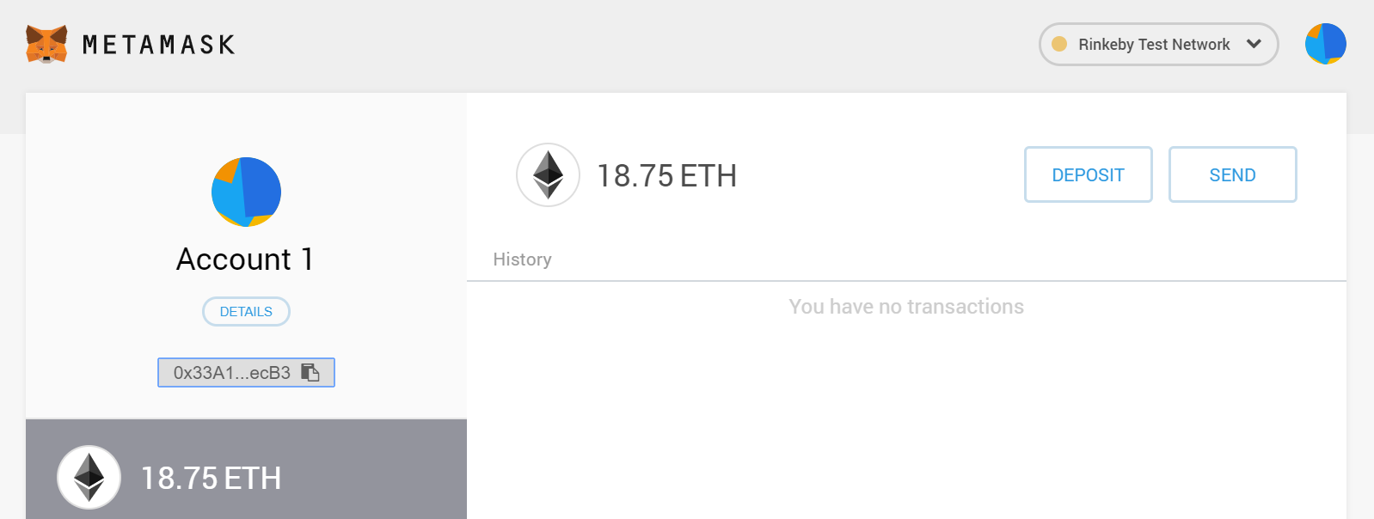

Slide 14
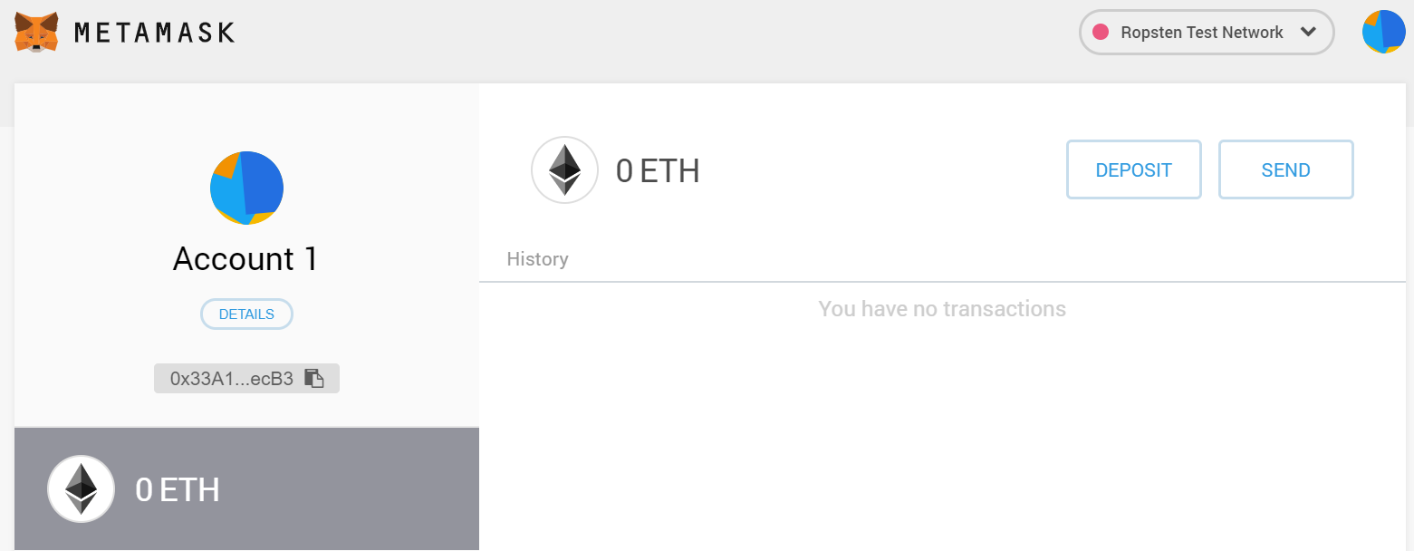
Every account we make in the world of ethereum is totally separate from any of the different ethereum networks.
Right now I have 18.75 ether in my account at rinkeby network, but on the other networks I have zero ethers.

Slide 15
Receiving Ether Procedure
Social network URL containing account address: Give me Ether.
Address sent to backend server. (web3 library is a tool used by developers to interact with any ethereum network)
Backend server used web3 library to create a transaction object
Backend server sent transaction object to the Rinkeby test network
Backend server waited for transaction to be confirmed
Backend server sent Ether sent message back to the browser

Slide 16
Transaction
A transaction is a record that contains a description about one account trying to send money to another account.
A transaction object is created whenever two accounts exchanged some amount of money, then the object is submitted to the ethereum network to be processed.
Transaction
Nonce:
To:
Value:
gasPrice:
startGas/gasLimit:
V:
R:
S:

Slide 17
The transaction object contains different fields assigned to it:
Nonce: Number of times the sender sent a transaction.
To: receiver’s account address.
Value: amount of ether to be sent to the receiver.
gasPrice: amount of ether the sender is willing to pay per unit gas to get this transaction processed.
startGas/gasLimit: units of gas this transaction can consume.
V, R, and S: cryptographic data that can be used to generate the sender’s account address. v, s, and r are generated from the sender’s private key.

Slide 18
The senders will use their private key to generate the V, R, S values.
Those three values can then be used to generate the account address of the sender.
Generating the V, R and S from the private key is a one way process, which means if you have the private key you can generate V, R, S values but if you have the V, R, S values you can’t reverse engineer it to get back the private key.
And by this property we can verify if a transaction is legitimate or not.

Slide 19
Transaction Confirmation
In receiving ether procedure, after sending the transaction to rinkeby network, step 5 stated that the Backend server waited for transaction to be confirmed.
When the transaction was sent to the rinkeby network, it was sent to one node in that network and not all nodes there.
And this node has an entire copy of the blockchain.
Node
Transaction
Node
Node
Node
Node

Slide 20

Since there are other users on the network, other transaction objects may be sent to the same node where our transaction was sent to too at the same exact time.
NODE
Transaction0
Blockchain
Transaction1
Transaction2
Transaction3

Slide 21
This node will take those transactions and combine all four transactions into one list of transactions called a block.
The node then run some validation logic on this block and the validation logic takes some time. In step 5 for receiving ether, we should wait some time to get confirmation for the sent transaction, the waiting time is due to the validation logic inside the node.
So when the transactions get combined into the block the node starts running some calculations on the block and that process is referred to as mining.
Validation logic refers to the mining process that occur inside the node.
NODE
Blockchain
T0
T1
Block
T2
T3

Slide 22
block time: the amount of time it takes to run the hash function many times until we find a valid value.
https://etherscan.io/chart/blocktime

Slide 23
Smart Contracts
Smart contract : an account controlled by a code, the code instructs the smart contract how to behave.
The external account is the account we created on Metamask, the external account can have different contract accounts, each contract account belongs to one specific network(Rinkeby etc)
Contract Account
Field | Description
Balance | Amount of ether belongs to this account
Storage | Data storage for this contract (any data related to the application)
Code | Machine code for this contract

Slide 24

Rinkeby
Contract Instance
Contract Source
Deployment
Contract Instance
Contract Instance
Using the contract source (source code) we can deploy multiple instances (contract accounts) in different networks.
The contract source acts like a class in object oriented, and the contract instance acts like an object (instance) of the class.
One of the languages used to write smart contracts is solidity, solidity is similar to java scripts.
Solidity files extension is .sol and its compatible with many code editors.

Slide 25
Solidity is a strongly typed language which means it has stricter typing rules at compile time, which implies that errors and exceptions are more likely to happen during compilation. Most of these rules affect variable assignment, return values and function calling.

Slide 26
Solidity will be used to write contracts definition, then the definition will be compiled into two parts:
a) byte code which will be deployed on the ethereum network,
b) Application Binary Interface (ABI) which will act as an interface between applications and the deployed contracts.

Slide 27
Ethereum Network
Application
(XML Code)
ABI
Contract Instance
(Byte Code)
For writing the first smart contract, an online code editor called remix can be used. https://remix.ethereum.org

Slide 28
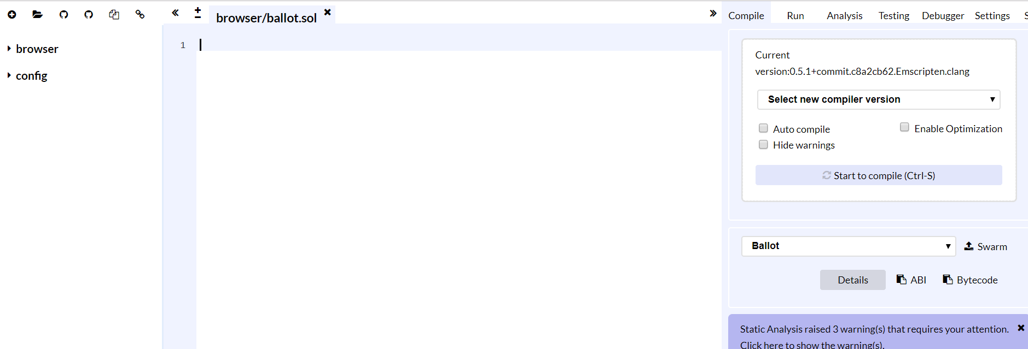

Slide 29
pragma solidity ^0.4.17;
contract Test {
string public message; // new variable
constructor(string initialMessage) public {
message = initialMessage;
}
function setMessage(string newMessage) public {
message = newMessage;
}
function getMessage() public view returns (string) { return message; }
}

Slide 30
Click the drop down menu named "Select new compiler version" and scroll down to find a version less than 0.4.19, such as 0.4.17+commit.bdeb9e52 and select it.
This will tell Remix to re-compile with that version and your errors should go away.
Note: Anytime you exit the browser you will need reset the compiler version

Slide 31
pragma solidity ^0.4.17;
Specifies the version of solidity that we are using inside this file.
Contract Test
Define a contract, the contract has functions and variables
String public message
Declare data variable message and its type that will be used in the contract.
constructor(string initialMessage) public {
message = initialMessage;
}
function setMessage(string newMessage) public {
message = newMessage;
}
function getMessage() public view returns (string)
{ return message; }
Constructor function, called automatically once the contract is created (when the contract is deployed in the blockchain).
Member functions definitions.
Contract, function, public, returns, return, string, view → keywords
Storage variable message → all instances of the Test contract will have the same value for the variable message
Local variables→ exist for one instance only.

Slide 32
Specify Return Type
Function Name
Function Type
function getMessage() public view returns (string)
{ return message; }
Function Type Examples:
Public: Could be called by any account in the ethereum network.
Private: could be called only by the contract that has this function.
View, constant: acts like an accessor function, it reads the contract data but it doesn’t change it (used with view/constant functions).
Pure: the function does not access nor mutate the contract data.
Payable: when called, the caller may send ether.

Slide 33
Test the Contract
Remix is a code editor but it also has a mini ethereum network simulator which can be used to simulate deploying and interacting with contracts (In browser network).
Remix mini ethereum
network simulator
Remix Editor
Contract Instance
Bytecode
Contract Source
Deploy

Slide 34
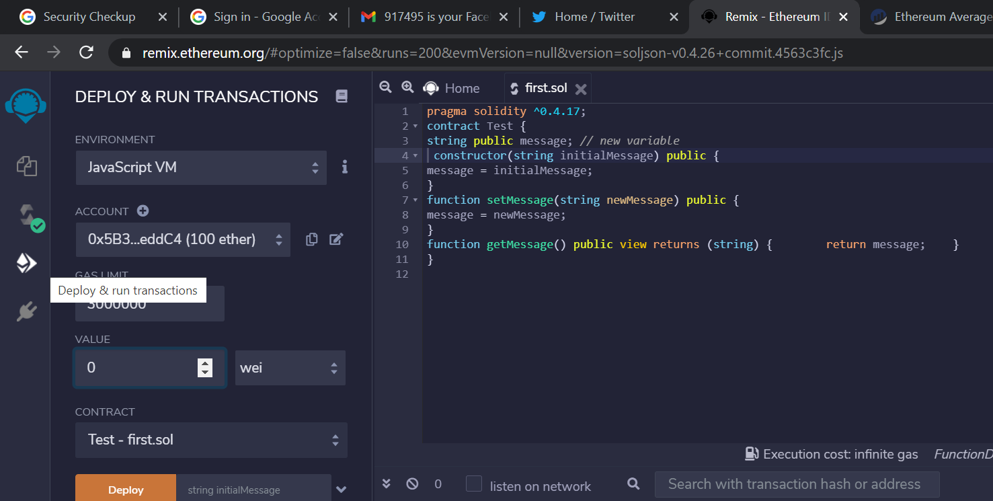

Slide 35
Click on the Deploy and Run tab.
The environment field: javascript VM, this allow us to deploy our contract to the in browser virtual ethereum network.
The account field contains different virtual accounts defined to be used in the in browser virtual ethereum network, each account is charged with 100 ether.
The value field is used to make a transaction and also to send some amount of ether with the transaction.
Under the value field, there is a drop down menu which contains a list of contracts, we will select the Test contract to deploy it inside the in browser virtual ethereum network.

Slide 36
Under the name of the contract field, there is a field to the right of it a button named Deploy, the field is used to initialize the constructor function parameter with some value, after filling the field with some value, an instance of the Test contract will be automatically created and the constructor function will be called (use “” for a string value).
Click on Deploy.
A new entry appears at the bottom which represents an instance of the Test contract that we deployed to the local test network.
Under that we see a list of the Test contract functions (buttons), these functions are the way to interact with the contract, if you click any of them it will automatically invoke the corresponding function inside the contract .

Slide 37
Message and getMessage are in blue because they are View or constant functions that can be called and will return data.
If we click on getMessage function we see some output preceeded with 0: it means this is the first return value from the function, if multiple values are being returned, we will see 1:, 2:.
The setMessage function is used to modify the contents of our contract, the setMessage function also tells us what type of input is expected when we call it.

Slide 38
If you mark a variable with the public keyword then solidity will automatically create a new function for that variable, the function will have the exact same name as the variable. The blue button labeled with message is an example.
If you call that function it will return the variable itself.
In other words the get message function that we created is a duplicate of some existing functionality that we already got for free.

Slide 39
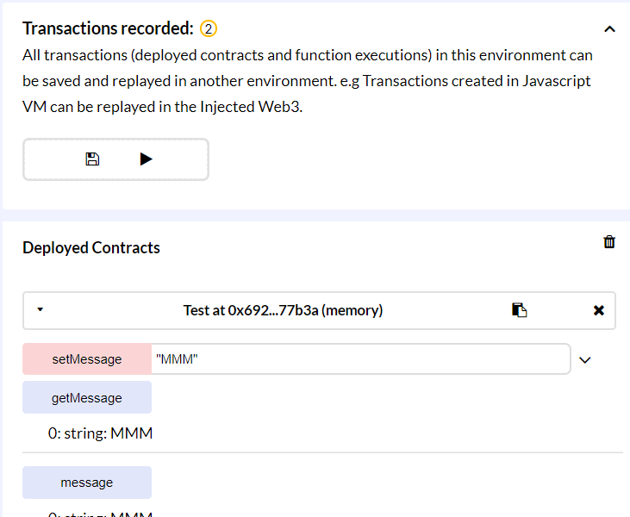
If we update the code inside the code editor, this update will not be reflected directly over the test instance of the contract that has been deployed before.
In order to get a new instance of the modified contract then we need to redeploy the contract.
First delete the opened instance by clicking on the x button top right the instance name.

Slide 40
To deploy the modified version of the contract, write a new initial message into the string input, then click on create, and this will create another instance of the contract.
In ethereum sending and receiving money between parties is represented by a transaction (Money sending transaction ), also creating a contract is represented by transaction (contract creation transaction).

Slide 41
Contract creation transaction is similar to normal transaction between different participants except for some difference (In red), using the external account, the following fields have to be filled to create a contract transaction:
Nonce: Number of times the sender sent a transaction (The sender here is person who creates the contract).
To: Blank (different than money sending transaction).
Data: Compiled bytecode of the contract.
Value: amount of ether to be sent to the receiver.
gasPrice: amount of ether the sender is willing to pay per unit gas to get this transaction processed.
startGas/gasLimit: units of gas this transaction can consume.
V, R, and S: cryptographic data that can be used to generate the sender’s account address. And v, s, and r are generated from the sender’s private key.

Slide 42
Sending money from one account to another is done by submitting a transaction, this transaction will be recorded on the Blockchain, hence the content of the Blockchain will be changed.
To create a contract and deploy it to the network we have to submit a transaction, to have the deployed contract available on the Ethereum network we need data storage to hold the contract instance and its variables data values, this process will change the content of the Ethereum Blockchain as well.
To change the content of the Ethereum Blockchain, either for sending money or to create and deploy a contract, we need to create a transaction.

Slide 43
After creating the transaction, we need to wait for some time to make sure the transaction has been confirmed.
After we created and deployed the Test contract, if someone used the setMessage function will that change the Blockchain? Is this happens as transaction too?
setMessage is changing the Blockchain and so it is performed as a transaction, while getMessage does not change the Blockchain, hence it does not submit a transaction.

Slide 44


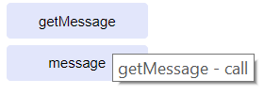
Contract Functions Invoking
Calling a function does not need to be mined, and does not involve submitting a transaction.
Any function that modifies data is performed by submitting a transaction to the contract instance that contains the function we want to use.
A function that modifies the contract data is not returning a data, instead it will return the transaction hash.
Using a contract functions
Calling Function | Sending a transaction to a function
Can’t modify contract’s data | Can modify contract’s data
Return data | Needs time to execute
Executes immediately | Return transaction hash
No Cost | Not free

Slide 45
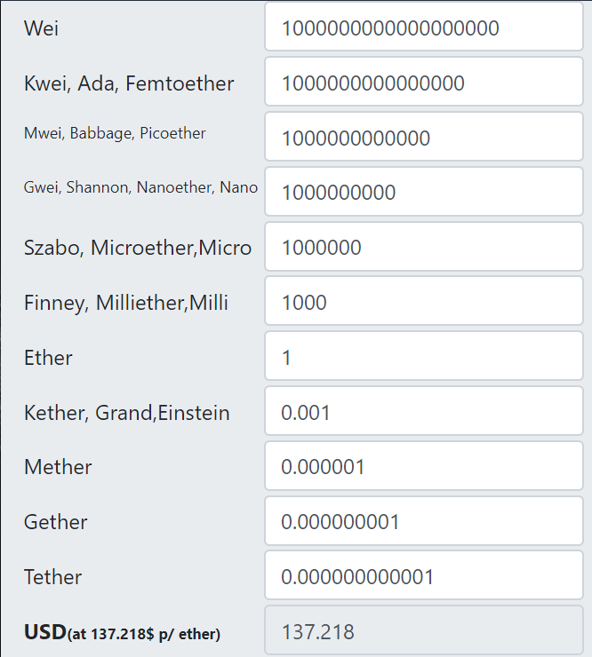
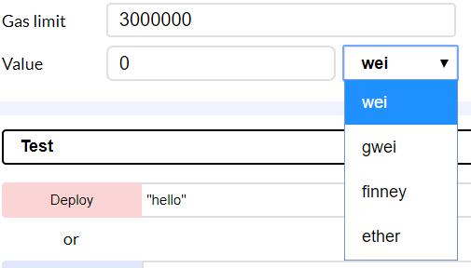
Under the run tab on remix, the value field has different options, wei, gwei, finney, and ether. These are units of measurement of the ether.
https://etherconverter.online/
1 ether = 10¹⁸ wei = 10⁹gwei = 10³ finney.

Slide 46
Gas measures how much work we execute in our code, if we want someone to run our contract then we need to compensate him for doing so, when we run/deploy a contract on the etheruem network there will be a gas price to run it.
If we add the following function to our Test program, then we need to know how much gas it will cost to run this function, and more specifically how much it cost for each operation in the function.
function calculate(int x, int y) public { x + y; x - y; x * y; x> y; }
gasPrice: amount of wei the sender is willing to pay per unit gas to get this transaction processed. Ex. If you are adding two numbers in some function, if the add costs 3 gas units, and we are willing to pay 5 weis, then the total will be 3*5 = 15 weis.

Slide 47
startGas/gasLimit: Units of gas this transaction can consume. In calculate function its easy to know how many gas unites we need to run the function (using the spreadsheet below we need 3+3+5+3 = 14 gas units).
But for complex functions containing large number of complex operations, or if there are loops in the code, then its not easy to know the exact number of gas units needed, instead we use the startGas/gasLimit as the maximum number of gas units we are willing to pay to run a function.
https://docs.google.com/spreadsheets/d/1n6mRqkBz3iWcOlRem_mO09GtSKEKrAsfO7Frgx18pNU/edit#gid=0

Slide 48
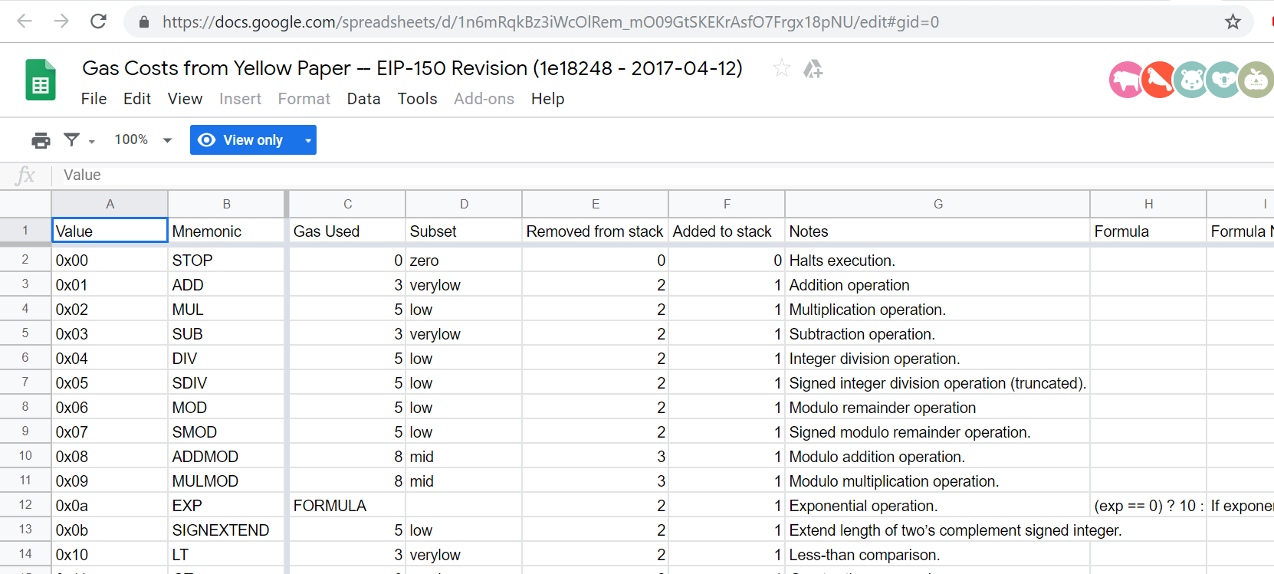

Slide 49
Ethereum Network
Calculate function
add
3 gas
Call function calculate transaction
sub
3 gas
gasPrice: 250
gasLimit: 8
mul
5 gas
GT
3 gas
-------------
Costs 14 gas

Slide 50
What happens when the gas gasLimit is less than the number of gas units needed to execute a function?
Once the transaction has been submitted to the network, it will invoke the calculate function, all the operations inside the function will start executing one by one.
The person/node that runs the contract will check for each operation if the number of needed gas has an available gas units depending on the gasLimit value, so the add operation which needs 3 gas units will be executed, then sub needs another 3 gas also get executed, then mul needs 5 gas units but the available gas units are two, as result the execution will stop, meaning the first two operations only get executed.

Slide 51
To solve the previous problem, the person who created the transaction will offer a higher gasLimit, say 30 gas units, in this case the function needs only 14 gas units, the rest will not be used and it will be sent back to the transaction creator.
The final cost for the previous transaction will be : 250 wei/gas x 14 gas = 3500 wei, this represents how much money to spend in order to execute the transaction.
Storing and modifying data costs money, this represents a challenge for Ethereum since users should design carefully their applications so that whatever contracts that will be used along with these applications it should not require a lot of money to execute.

Slide 52
In Ethereum a user could have multiple accounts, for example in MetaMask a user could have more than one account, where each account has it own account address, private key, and public key.
If a user has multiple accounts and each account has its own account address, private key, and public key, it would be hard for the user to memorize all these information.
To make it easier for the users, Ethereum utilized the concept of a 12 word mnemonic, where a 12 word mnemonic allows the user to automatically generate a series of different accounts with a public key a private key and an address. This helps the user to manage his key efficiently.

Slide 53
The 12 word mnemonic is a series of 12 random words easy to memorize, same like the 12 word phrase you saw when you created your account on MetaMask.
The 12 words mnemonic is fed into the BIP32 mnemonic algorithm which will generate a series of different accounts each of which have their own public key private key and address.
Instead of memorizing multiple different keys that belongs to different accounts, the user needs only to memorize the 12 word mnemonic.

Slide 54
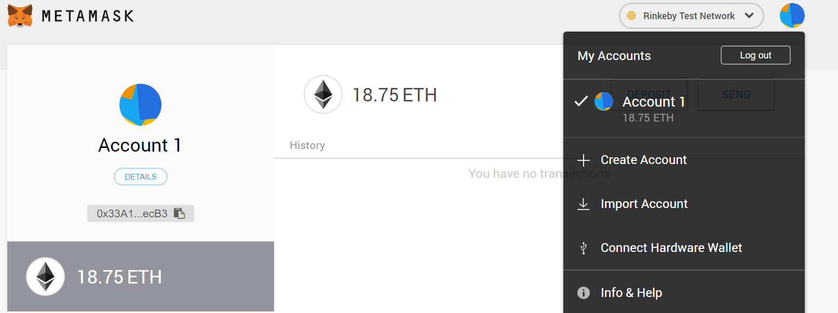
In MetaMask, if you click on the blue circle, you can select between multiple accounts generated from the same mnemonic phrase, and you can create a new account generated from the same mnemonic phrase too.
To reset the account:
Open the “My Account” page by clicking the icon on the upper right corner, and select “Settings”
On the “Setting” page, scroll down to find “Reset Account”.
Click “Reset Account”

Slide 55
https://iancoleman.io/bip39/
This is a mnemonic code converter tool which can be used to either generate a new mnemonic or to restore all of the accounts from an existing one.
We need to have an up-to-date version of Node JS. At least we need to have version 8.0.0 of Node JS. To check the current version, run node –v at the command prompt.
https://nodejs.org/en/download/

Slide 56
The Test contract we wrote before using Remix was deployed on VM JavaScript environment, we need to make some modification to the Test Contract if we want to deploy it in the Rinkeby or other test networks.
The Remix code editor contains the solidity compiler which provide us with two outputs, the ABI and the Contract Bytecode, we need to know how to deploy the Contract Bytecode of our Test contract over the Rinkeby network.
There is a tool called Truffle that is used for contract creation, local testing, and deployment.
Contract Source
Solidity Compiler
ABI
Contract Bytecode
Rinkeby

